Slide 1
by Chandan Shukla Gaurav Sharma
BENGALURU HOUSE PRICE PREDICTION

Slide 2
Abstract
We propose to implement a house price prediction model of Bangalore, India. It’s a Machine Learning model which integrates Data Science and Web Development. We have deployed the app on the Streamlit. Housing prices fluctuate on a daily basis and are sometimes exaggerated rather than based on worth.
The major focus of this project is on predicting home prices using genuine factors.

Slide 3
Introduction
Context
Motivation
Objective
Literature Survey
Methodology
Data Collection
Linear Regression

Slide 4
Context
This project was made because we were intrigued and we wanted to gain hands-on experience with the Machine Learning Project

Slide 5
Motivation
We are highly interested in anything related to Machine Learning, the independent project provided us with the opportunity to study and reaffirm our passion for this subject. The capacity to generate guesses, forecasts, and offer machines the ability to learn on their own is both powerful and infinite in terms of application possibilities.

Slide 6
Literature Survey
Real Estate Property is not only a person's primary desire,
but it also reflects a person's wealth and prestige in
today's society
Real estate investment typically appears to be lucrative since property values do not drop in a choppy fashion.
Changes in the value of the real estate will have an impact on many home investors, bankers, policymakers, and others.

Slide 7
Methodology
1. Data Collection –
The statistics were gathered from Bangalore home prices
The information includes many variables such as area type, availability, location, BHK, society, total square feet, bathrooms, and balconies.

Slide 8
Methodology
2. Linear Regression –
Linear regression is a supervised learning technique
It is responsible for predicting the value of a dependent
variable (Y) based on a given independent variable (X)
It is the connection between the input (X) and the output (Y).
It is one of the most well-known and well-understood machine learning algorithms.

Slide 9
Problem Statement
Create a model to estimate the price of houses in Bengaluru and host it on Heroku.
Data - The data is the most important aspect of a machine learning assignment, to which special attention should be paid. Indeed, the data will heavily affect the findings depending on where we found them, how they are presented, if they are consistent, if there is an outlier, and ensure that the learning algorithm is efficient and correct

Slide 10
The proposed methodology related to our project is given below
Step 1:
We will implement a Bangalore House Price Prediction model using a Machine Learning algorithm. This model predicts the price of Bangalore's house with the help of a few parameters like availability, size, total square feet, bath, location, etc.

Slide 11
The proposed methodology related to our project is given below
Step 2:
The preprocessing of the dataset is done. It involves the following steps:
• Exploratory data analysis
• Dealing with a missing values or noisy data
• Data preprocessing
• Create new features from existing features
• Remove outliers
• Data visualisation

Slide 12
The result is obtained
Extraction of Dataset from Kaggle
• Pre-processing of Data to remove some useless attributes
• Processing of Data to analyze the best possible algorithm for price prediction
• Takes input of locality, number of rooms and bathrooms, and area in square feet
• Displays the predicted house price

Slide 13
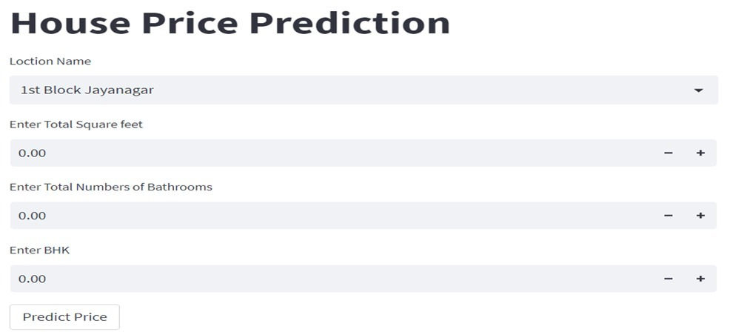
Result

Slide 14
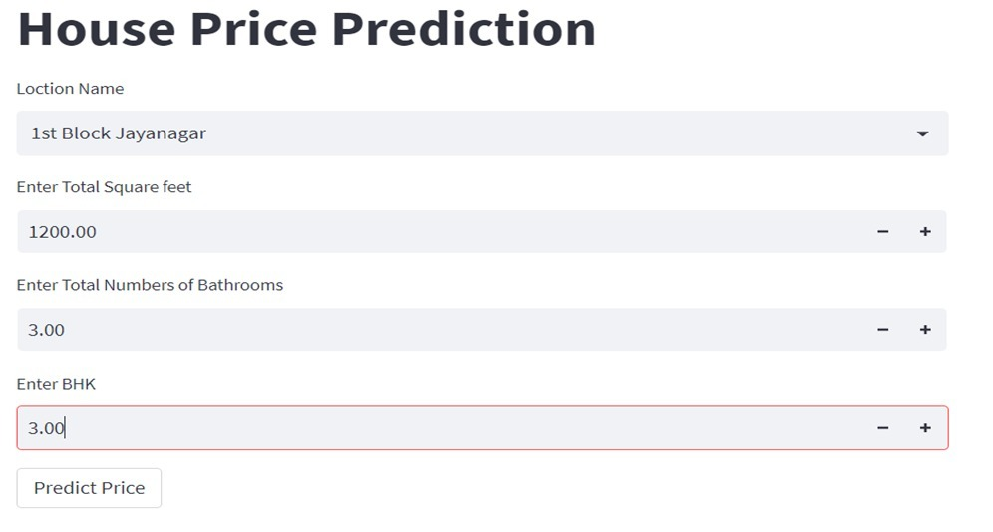

Slide 15
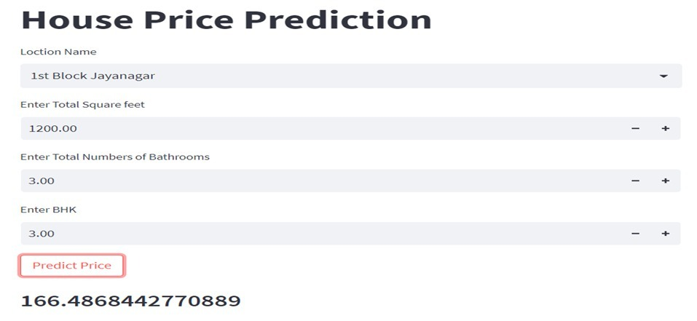

Slide 16
References
[1] Model “BENGALURU HOUSE PRICE PREDICTION MODEL”
[2] Repository: “Web Application” https://github.com/ChandanShukla95/Ban glore_House_Prediction.git
[3] Pickle ‘’Documentation’’
[4] A. Varma, A. Sarma, S. Doshi and R. Nair, "House Price Prediction Using Machine Learning and Neural Networks," 2018 Second International Conference on Inventive Communication and Computational Technologies (ICICCT), 2018, pp. 1936-1939, doi:10.1109/ICICCT.2018.8473231.

